Slide 1
Experimental design and analysis in software engineering
By : Rewan Ahmed Abd-Elstar
Hadeer Yousry
Samar Alaa El-din yaqout

Slide 2
Introduction
As a software practitioner, it is important to make key decisions or assessments in an objective and scientific way.
->So we need to know two things: what assessment techniques are available to us, and which should be used in a given situation?
the paper will help you to determine whether an experiment is appropriate for your evaluation, to design the experiment, and to derive meaningful results from it.

Slide 3
CHOOSING A RESEARCH TECHNIQUE
This section addresses the differences between case studies and formal experiments.
Stating the Hypothesis
decide what you want to investigate.
The hypothesis is the tentative theory or supposition that you think explains the behavior you want to explore.
you are testing to see if the data you collect will confirm or refute the hypothesis you have stated.
It is important to recognize that quantifying the hypothesis often leads to the use of surrogate measures so you should document the relationship between the measures and the factors they intend to reflect.

Slide 4
Control over Variables
you must decide which variables can affect its truth, and how much control you have over each variable.
The key discriminator between experiments and case studies is the degree of control over behavioral events and the variables they present.
A case study is preferable when you are examining events where relevant behaviors cannot be manipulated.
Experiments are done when you can manipulate behavior directly, precisely and systematically.
This difference between case studies and formal experiments can be stated more rigorously by considering the notion of a state variable.
A state variable is a factor that can characterize your project and influence your evaluation results.
a state variable is used to distinguish the "control" situation from the "experimental" one in a formal experiment.

Slide 5
Uses of Formal Experiments
Confirming Theories and "Conventional Wisdom“
Formal experiments can be used to provide a context in which certain standards, methods and tools are recommended for use.
Exploring Relationships
Understanding relationships is crucial to the success of any project. Each relationship can be expressed as a hypothesis, and a formal experiment can be designed to test the degree to which the relationship holds.
a good experimental design would ensure that factors such as programmer experience, application type, or development environment were controlled so that they would not confuse the results.

Slide 6
Evaluating the Accuracy of Models
Models are often used to predict the outcome of an activity or to guide the use of a method or tool.
Validating Measures
Many software measures have been proposed to capture the value of a particular attribute.
Validating measures is fraught with problems.
validation is performed by correlating one measure with another.
the measures used must conform to human notions of the factor being measured.

Slide 7
Factors to Consider when Choosing Formal Experiments
the central factor is the level of control needed for a formal experiment.
the degree to which you can replicate the basic situation you are investigating.
PRINCIPLES OF FORMAL EXPERIMENTS
This section discusses the planning needed to define and run a formal experiment.
Procedures for Performing Experiments
There are several steps
• conception • design
• preparation • execution
• analysis • dissemination and decision-making

Slide 8
Conception
The first step is to decide what you want to learn more about, and define the goals of your experiment. Next, you must state clearly and precisely the objective of your study.
Design
you must translate the objective into a formal hypothesis, there are two hypotheses : null hypothesis and the experimental (or alternative) hypothesis.
The null hypothesis is the one that assumes that there is no difference between two treatments , The alternative hypothesis posits that there is a significant difference between the two treatments.
Hypothesis definition is followed by the generation of a formal design to test the hypothesis. The experimental design is a complete plan for applying differing experimental conditions to your experimental subjects

Slide 9
Preparation
Preparation involves readying the subjects for application of the treatment.
Execution
the experiment can be executed.
Analysis
The analysis phase has two parts. First, you must review all the measurements taken to make sure that they are valid and useful. Second, you analyze the sets of data according to the statistical principles
Dissemination and Decision-Making
It is important to document both methods and conclusions in a way that will allow your colleagues to duplicate your experiment and confirm your conclusions in a similar setting.

Slide 10
Principles of Experimental Design
we examine the principles that you must consider in designing your experiment. Each principle addresses the need for simplicity and for maximizing information.
in the experimental design are two important concepts: experimental units and experimental error.
an Experimental unit is the experimental object to which a single treatment is applied. Experimental error describes the failure of two identically treated experimental units to yield identical results.
The aim of a good experimental design is to control for as many variables as possible, both to minimize variability among participants and to minimize the effects of irrelevant variables
Replication : is the repetition of the basic experiment.
replication involves repeating an experiment under
identical conditions, rather than repeating
measurements on the same experimental unit.

Slide 11
*Randomization : is the random assignment of subjects to
groups or of treatments to experimental units
*Randomization does not guarantee independence, but it allows us to assume that the correlation on any comparison of treatment is as small as possible.
*Local control is the aspect of the experimental design that reflects how much control you have over the placement of subjects in experimental units and the organization of those units.
*Local control is usually discussed in terms of two characteristics of the design:
- blocking & balancing the units

Slide 12
* Blocking means allocating experimental units to blocks or groups so the units within a block are relatively homogeneous.
* Balancing is the blocking and assignment of treatments so that an equal number of subjects is assigned to each treatment, wherever possible. Balancing is desirable because it simplifies the statistical analysis, but it is not necessary
3. Types of Experimental Designs :-
- Crossing
- Nesting

Slide 13
- Crossing Experimental Design:-
The design of an experiment can be expressed in a notation that reflects the number of factors and how they relate to the different treatments. Expressing the design in terms of factors, called the factorial design, tells you how many different treatment combinations are required.
- Nesting Experimental Design:-
Nesting can involve more than two factors.
*more complex designs can be created as nesting and crossing are combined.

Slide 14
4- Selecting an Experimental Design :-
- Choosing the Number of Factors
- Factors vs. Blocks
- Choosing between Nested and Crossed Designs
- Fixed and Random Effects
- Matched or Same Subject Designs
- Repeated Measurements
1. Choosing the number of factors :
- Many experiments involve only one variable factor.
- The experiments may be quite complex, in that
there may be many levels of the variable that are
compared

Slide 15
2- Factors & Blocks :
- use blocks to eliminate bias; use factors to distinguish
cases or circumstances.
3- Choosing between Nested and Crossed Designs :
- The nested design is analyzed differently from the crossed
design (a one-way analysis of variance, as opposed to a
two-way analysis of variance), so there is no risk of
meaningless interaction effects, as there was with the
crossed design
4- Fixed and Random Effects :
-The difference between fixed- and random-effects models affects the way the resulting data is analyzed. For completely randomized experiments, there is no difference in analysis. But for more complex designs, the difference affects the statistical methods to assess the results. If you are not using a completely randomized experiment, you should consult a statistician to verify that you are planning to use techniques appropriate to the type of effects in your model.

Slide 16
5- Matched or Same Subject Designs :
-We can use the same subjects for different treatments, or we can try to match subjects according to their characteristics in order to reduce the scale and cost of the experiments.
6- Repeated Measurements :
-Each developer was asked to calculate the number of function points in the product at each of three different times during development: after the specification was completed, after the design was finished, and after the code was done

Slide 17
ANALYZING THE RESULTS OF EXPERIMENTS
This section describes the items you must consider in choosing
the analysis techniques. Specific statistical techniques are described and used in the discussion are found in [Kitchenham 1992; Caulcutt 1993; Chatfield 1993].
There are three major items to consider when choosing your analysis techniques:
the nature of the data you collected, why you performed the experiments, and the type of experimental design you used.

Slide 18
Distribution of Data
The nature of your data will help you to decide which analysis techniques are available to you. Because you do not have infinite resources, you are using your relatively small sample to generalize to that larger population, so the characteristics of the population are important. Many statistical techniques assume that the data is normally distributed, and your sample is randomly chosen from that larger distribution.
However, most software-related measurements are not normally distributed.
Whereas a normal distribution is continuous and symmetric about its mean, much software data is discrete and not symmetric. In fact, it is unusual for software data
to be a random sample from a well-defined population.

Slide 19
There are several ways to analyze data that is non-normal:
Use robust statistics and non-parametric analysis methods.
Transform your measurements to a scale (such as the logarithmic scale) that conforms more closely to a normal distribution.
Determine the true underlying distribution and choose techniques appropriate to it.
(In the examples that follow, we will consider both normal and non-normal cases,depending on the type of data)

Slide 20
Purpose of the Experiment
four major reasons to conduct a formal experiment:
to confirm a theory.
to explore a relationship.
to evaluate the accuracy of a model.
to validate a measure.
Confirming a Theory
The theory usually states that use of a certain method, tool or technique (the treatment) has a particular effect on the experimental subjects, making it better in some way than another treatment .
There are two cases to consider: normal data and non-normal data. If the data comes from a normal distribution and you are comparing two groups, you can use the Student's t-test to analyze the effects of the two treatments, If you have more than two groups to compare, a more general analysis .

Slide 21
Exploring a Relationship
Often, an experiment is designed to determine the relationship among data points describing one variable or across multiple variables. For example, you may be interested in knowing the normal ranges of productivity or quality on your projects,
so that you have a baseline to compare for the future.
Evaluating the Accuracy of a Model
a model of behavior is used to predict what should happen. These predictions aid the project manager in making major decisions about resource planning and the duration or extent of activities.
Validating a Measure
Validating a measure means verifying that the measure actually captures the attribute it claims to reflect. For example, the McCabe cyclomatic complexity measure [McCabe 1976] claims to capture the complexity of source code.

Slide 22
Design Considerations
The experimental design must be considered in choosing the analysis techniques.For complex factorial designs with more than two factors, more sophisticated tests of association and significance must be used. These techniques are beyond the scope of this paper, and you should consult a statistician for help with this type of design.
Decision Tree
To help you understand when to use one analysis technique or another, we have constructed a decision tree to take into account the major considerations discussed in this section (see table 2).
The decision tree is to be read from left toright.

Slide 23
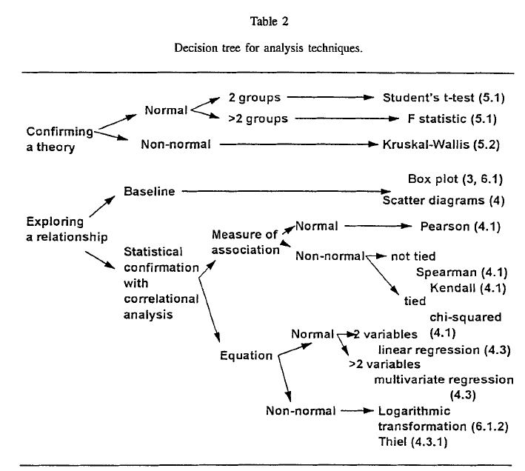

Slide 24
Summary
We have described the key activities necessary for designing and analyzing an experiment in software engineering, We began by explaining how to choose an appropriate research technique to fit the goals of your project. In particular, we taught you how to state your hypothesis and determine how much control you need over the variables involved. If control is not possible, then a formal experiment is not possible; a case study may be a better approach.
Next, we explained the principles of formal experimentation. We listed the six stages of an experiment: conception, design, preparation, execution, analysis and dissemination.

